Slide 1

Constrained Application Protocol(CoAP)
Made by Keyhan Masoudi
Sharif University of Technology Dr.Amin Foshati

Slide 2

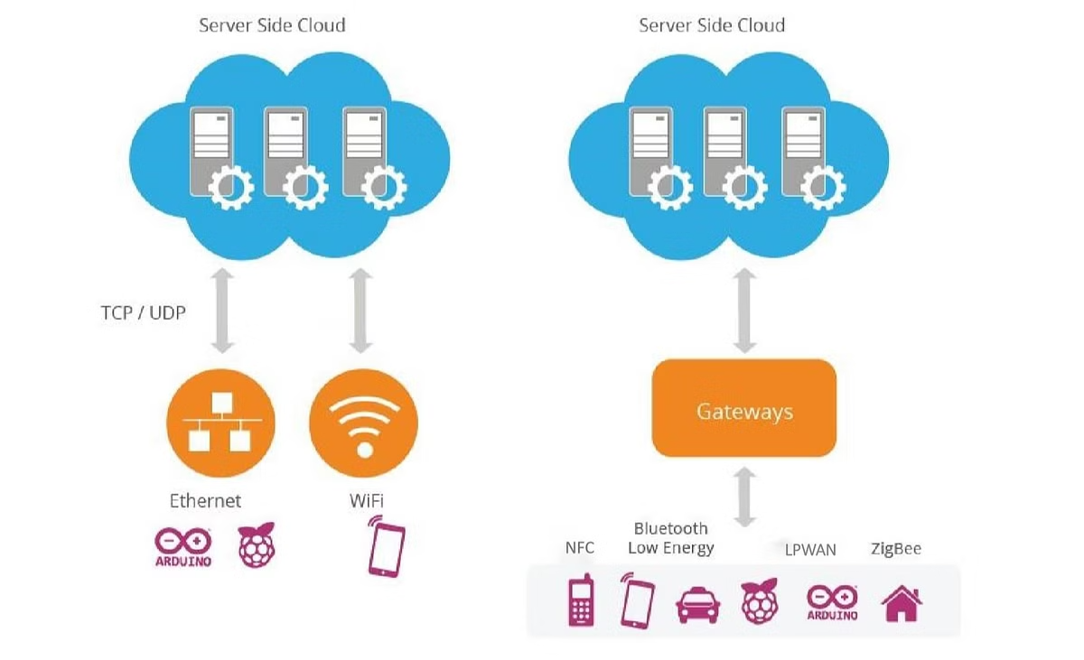
What is CoAP
The Constrained Application Protocol (CoAP) is a lightweight web transfer protocol designed for constrained devices and networks. It is optimized for applications in the Internet of Things (IoT), ensuring low power consumption and efficient bandwidth usage.

Slide 3
Purpose of Development CoAP
Why CoAP?
Efficient communication in low-bandwidth, high-latency networks.
Easily adaptable to various devices across IoT applications
Send information to multiple devices simultaneously.
Low resource consumption for constrained devices.
Easy integration with web technologies.

Slide 4

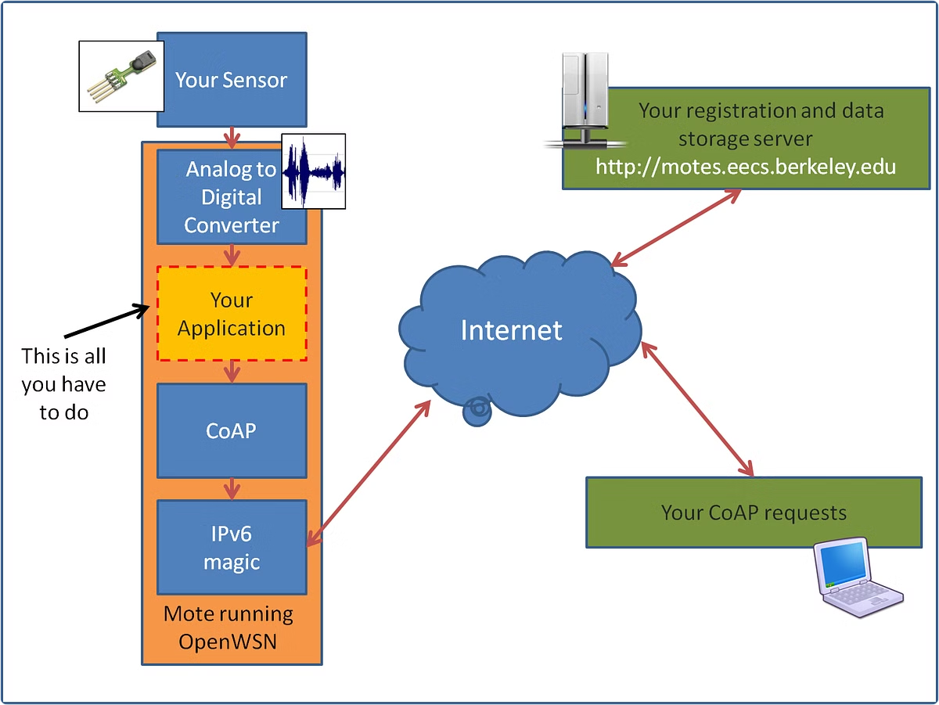
Applicatioin Layer Connections
Optimized RESTful architecture
Supports block-wise transfer
Supports optional secure communication through DTLS.
Supports resource discovery
Caching repeated data

Slide 5
Communication Type and Encoding
1
Serial Communication
2
Encoding
Compact binary format to minimize overhead.
CoAP messages are transmitted serially.
3
Signal Production
Utilizes UDP packets for asynchronous, low-latency communication.

Slide 6


Device Connectivity
Multi-Device Capability
Allows multiple devices to communicate with a single server.

Slide 7


Addressing and Routing
IP Addressing
To identify and communicate with devices
Supports unicast (1-to-1 and 1-to-many)
1
No Routing Features
2
Routing is managed by underlying network protocols (e.g., RPL).

Slide 8
Data Flow Management
Flow Control
1
Managed by message acknowledgment.
Message Deduplication
Ignore duplicate messages
2
Retransmission Mechanism
3
Ensures data reliability in case of packet loss.

Slide 9
Error Detection
1
2
Data Link Layer
Higher Layers
Integrity is maintained through UDP checksums.
Application-level errors are identified through response codes(e.g,4.04).
Error Correction
CoAP primarily focuses on error detection and retransmission rather than complex error correction techniques.

Slide 10
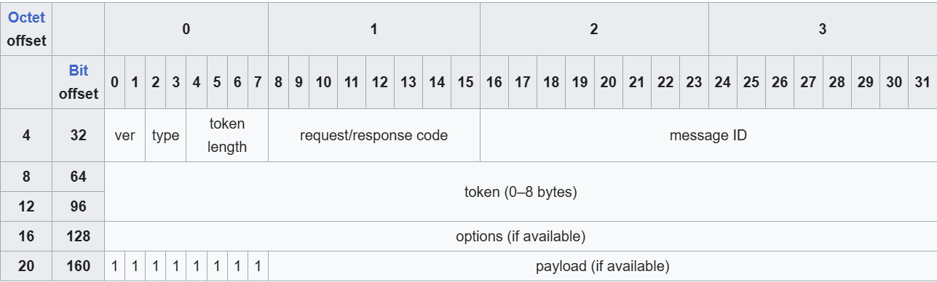
Message Types and Formats
Version
Type
Token Length
Code
Message ID
Options
Payload
CoAP uses four message types:
Confirmable.
Non-confirmable.
Acknowledgment.
Reset.

Slide 11
Thanks for your attention
Under the guidance of Dr.Foshati
Interface Circuits Design
Fall 2024

Slide 12
Reference
https://www.geeksforgeeks.org/constrained-application-protocol-coap/
https://devopedia.org/constrained-application-protocol
https://core-wg.github.io/new-block/draft-ietf-core-new-block.html
http://rfc-editor.org/rfc/rfc7252.html
https://coap.space/\

